Slide 1
Statistical Analysis of Cybersecurity Breaches
Mantha Sai Prasanth
11707043
Instructor: Dr. Gahangir Hossain
Data Visualization INFO 5709
Data Visualization – Term Project
05/08/2024

Slide 2
Table of Contents
Introduction
Dataset Discription
Attributes Used
Data Cleaning
Exploratory Data Analysis
Hypothesis
Dashboard
Conclusion
References

Slide 3
Introduction
Importance of Cybersecurity
  Cybersecurity measures protect against a range of cyber threats, such as malware, ransomware, phishing attacks, and other forms of cyberattacks that can compromise personal and organizational data.
Objective of the Analysis:
  To identify trends and patterns in cybersecurity breaches over the years.To understand the common types of breaches and their impacts.
  To utilize data visualization techniques to communicate findings effectively.

Slide 4
Impact of Breaches on Security and Data Integrity
  Discuss the potential risks and consequences of cybersecurity breaches, including data loss, financial damage, and erosion of trust.
  Mention the broader implications for privacy, regulatory compliance, and security policies
Purpose of the Project
  To provide actionable insights that can help organizations strengthen their cybersecurity defenses.
  To inform policymakers and stakeholders about the current cybersecurity landscape to guide future strategies.

Slide 5
Dataset Discription
Source of Data:
  The dataset was obtained from Kaggle, a platform known for hosting a variety of datasets that are used for analytical competitions and research purposes.
Scope of Data:
  The dataset covers cybersecurity incidents from the years 2010 through 2014, providing a specific window into cybersecurity trends over these five years.
Comprising 1056 entries, the dataset offers detailed insights with each entry meticulously documented.This comprehensive data collection allows for an in-depth analysis of cybersecurity incidents across various sectors.

Slide 6
Attributes
The dataset includes 15 attributes for each record, such as
  Breach End
  Breach Start
  Business Associate Involved
  Date of Breach
  Date Posted or Updated Location of Breached Information
  Name of Covered Entity
  State
  Summary
  Type of Breach
  Year
  Breach_No F1
  Individuals Affected
  Number of Records

Slide 7
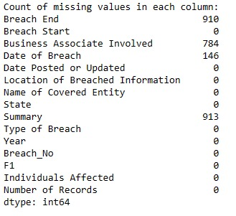
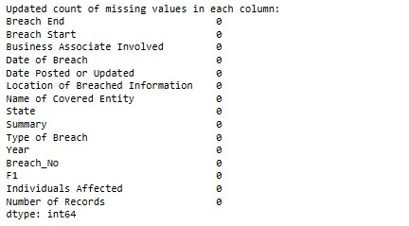
Data Cleaning
Identification of Missing Values:
  Thoroughly review the dataset to identify missing values across various attributes, such as 'Breach End', 'Business Associate Involved', 'Date of Breach', and 'Summary’.
  This step is crucial to understand the extent of data incompleteness and plan subsequent cleaning processes.

Slide 8
Exploratory Data Analysis
EDA is used to uncover the underlying structure of the data, identify important variables, detect anomalies and outliers, and test assumptions.
Overview of EDA
  Data Cleaning
  Visualization
  Summarization
Purpose OF EDA
  Maximize Insight into a Dataset
  Develop Parsimonious Models
  Provide Evidence for Future Data Collection and Analysis

Slide 9
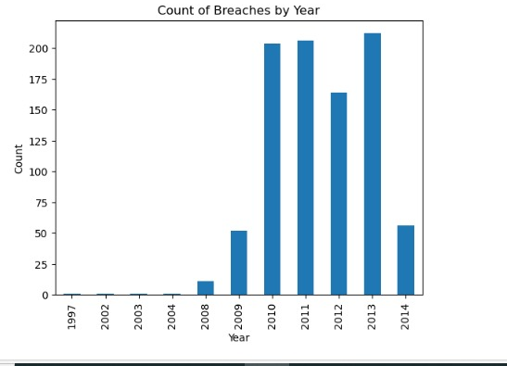
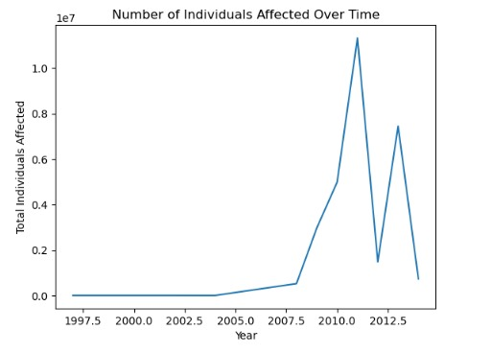
Q)In which year the count of Breaches was more and from which year there was a spike in the Breach?
Q) What year, based on the graph, had the most people affected by breaches?

Slide 10
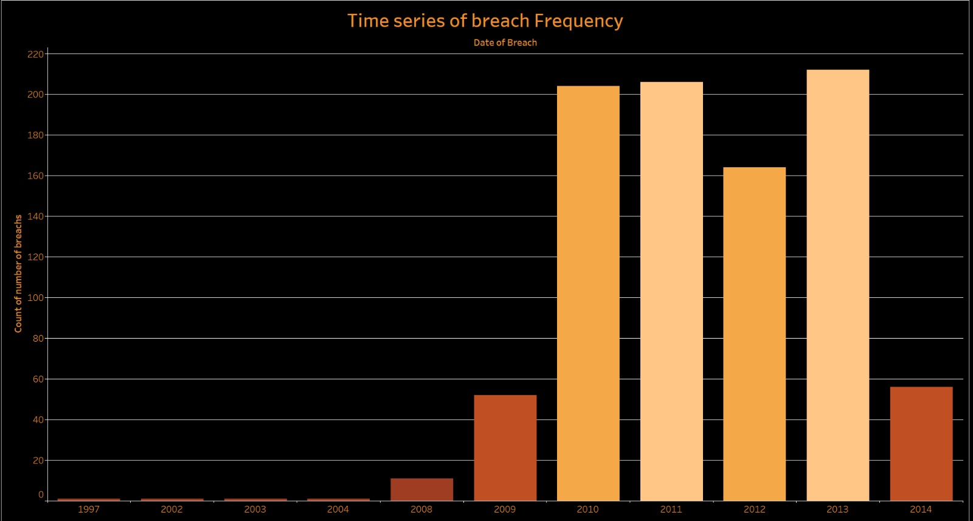
Hypothesis & Visualizations
1) Does the involvement of business associates correlate with an increase in the frequency of breaches?
Result:
a) 2013 becomes the highest point, with the tallest peach-colored bar depicting the largest number of breaches within the shown period. After that, breach frequency slightly declines after 2011, but it remains relatively high throughout the years 2012, 2013, and 2014, as depicted by the towering peach-colored bars during those year

Slide 11
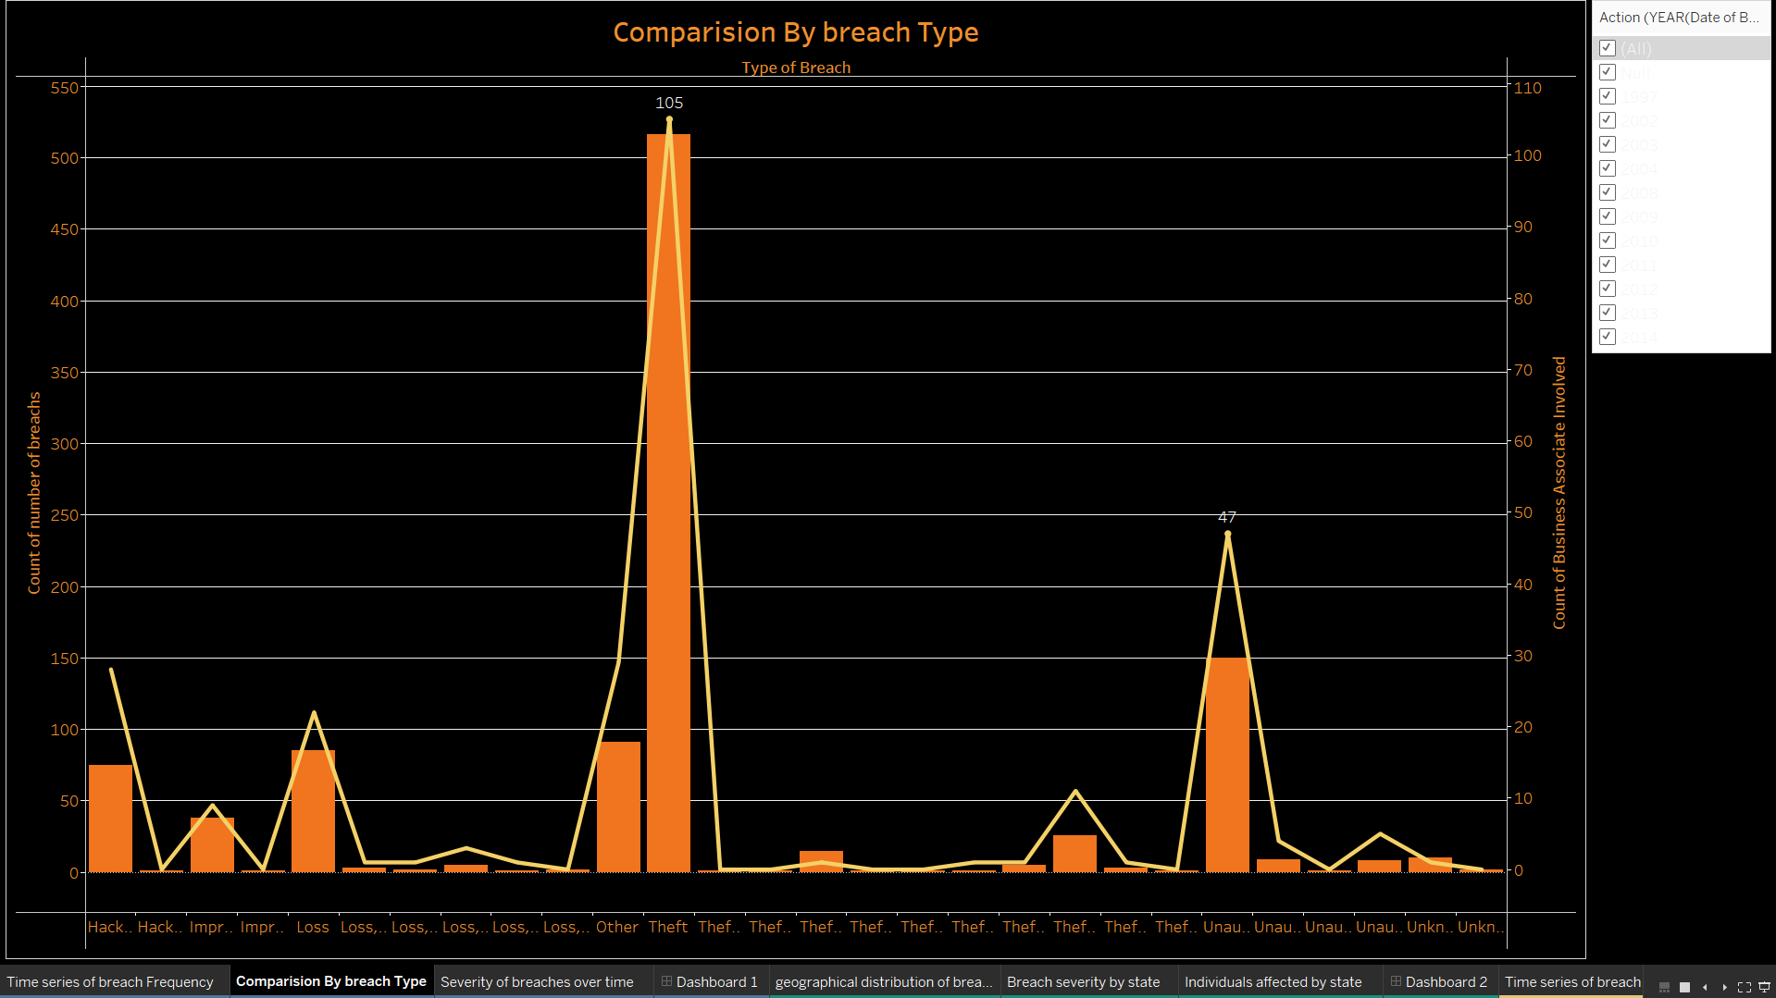
b) Combination Chart of both Bar Graph and Line Graph
b) Result:
The graph exhibits several distinct peaks, with the highest peak reaching approximately 110 incidents for the breach type labeled "Loss". Notable peaks also include around 105 incidents for "Theft" and roughly 100 incidents for "Improper Disposal".

Slide 12
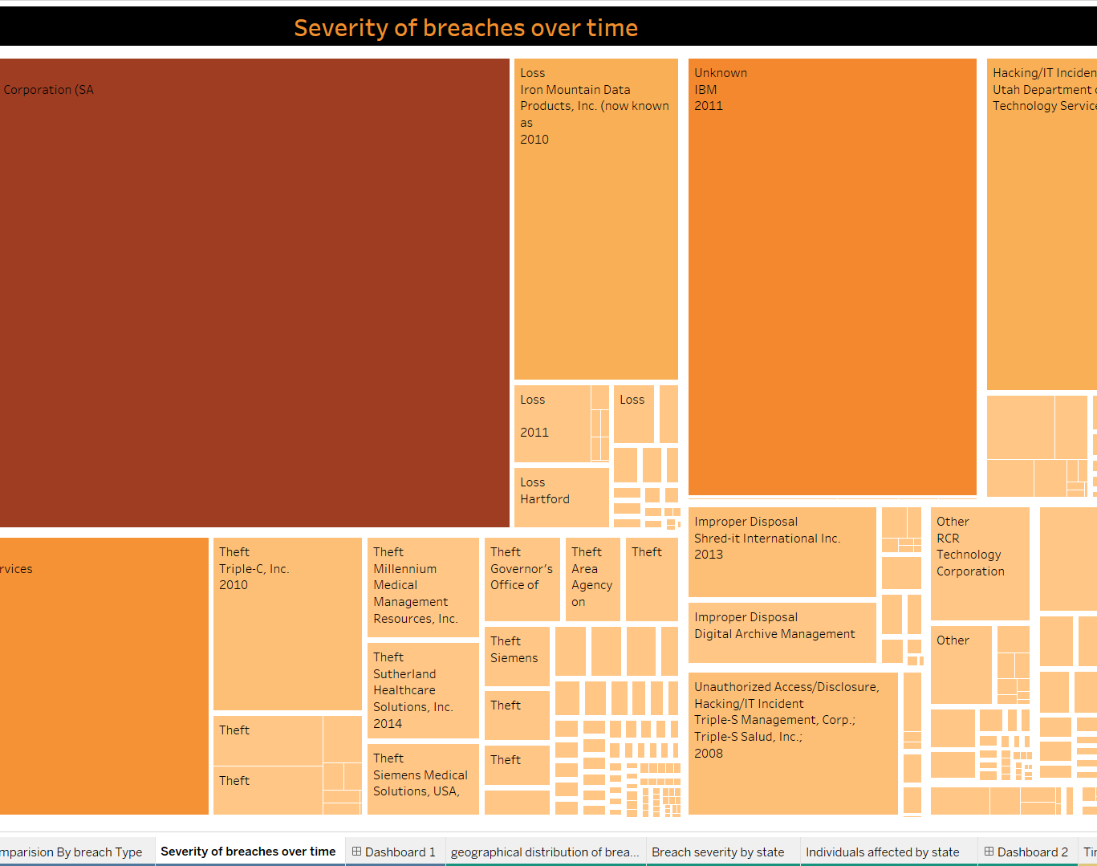
c) Tree Map
Result:
This visualization helps in comparison over time in the relative severity or impact of different data breach incidents, which will have larger rectangles representing more severe events. The main insight from this visualization is in identifying the kinds of breaches faced by various organizations, such as data loss, theft, improper disposal, and unauthorized access or hacking.

Slide 13
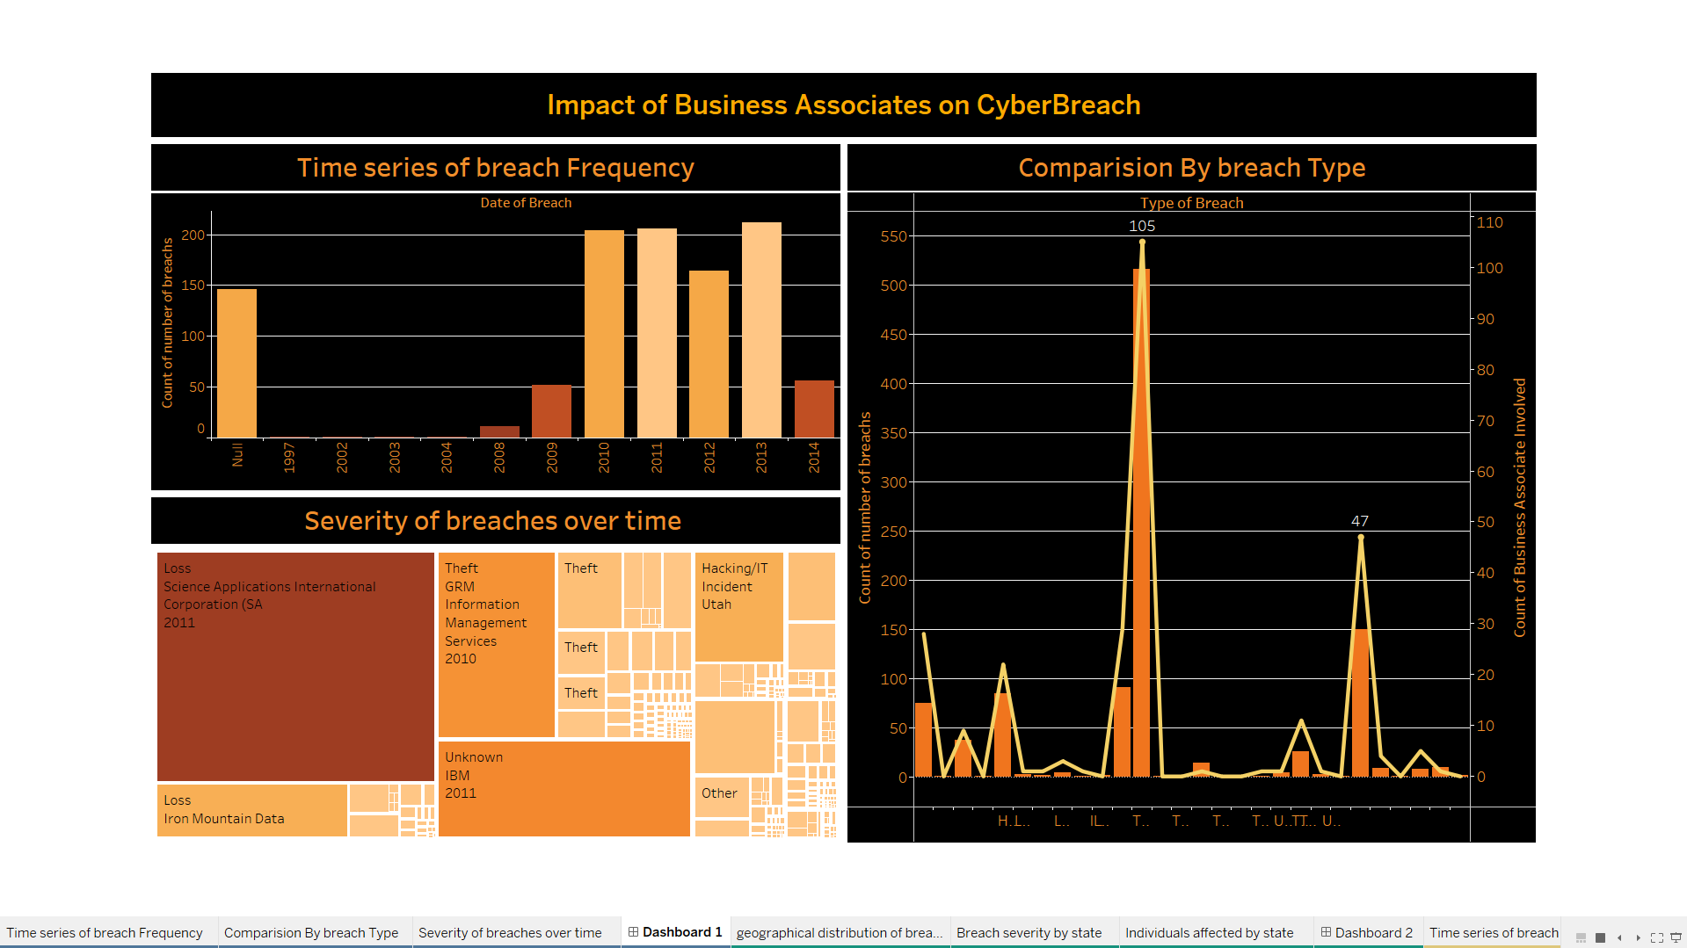
Dashboard
Result:
This correlation appears particularly strong in 2011, a peak year for both metrics. This suggests that years with significant business associate involvement also experienced high numbers of breaches, indicating a potential correlation between these factors.

Slide 14
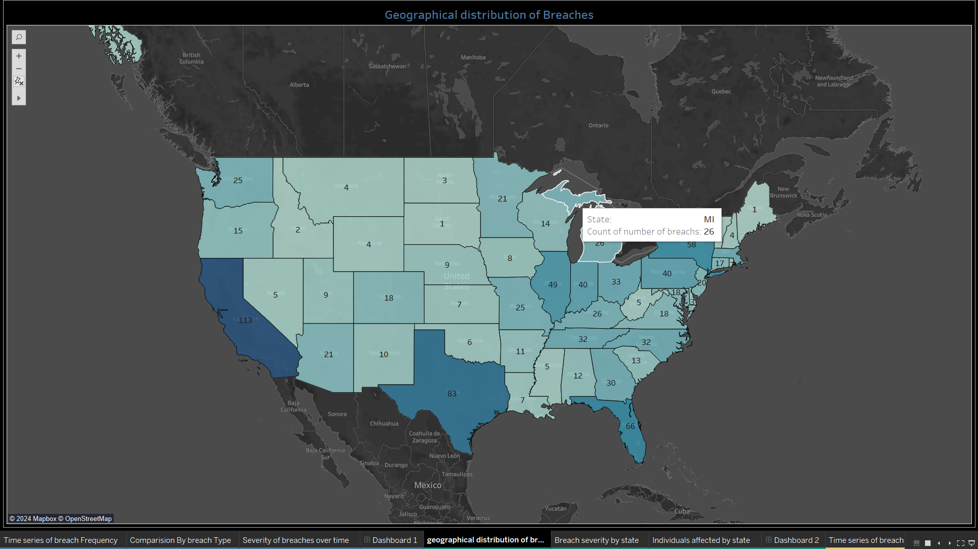
2) Is there a geographical pattern to where breaches occur and the number of individuals affected?
Geographical Representation:
Result:
This map clearly visualizes which states have a higher incidence of cyber security breaches. For example, California, Texas, and Florida show much darker shades, pointing to a higher number of breaches. This visualization enables stakeholders to quickly identify and focus on higher-risk areas for targeted cybersecurity measures, policy implementation, or further detailed analysis.

Slide 15
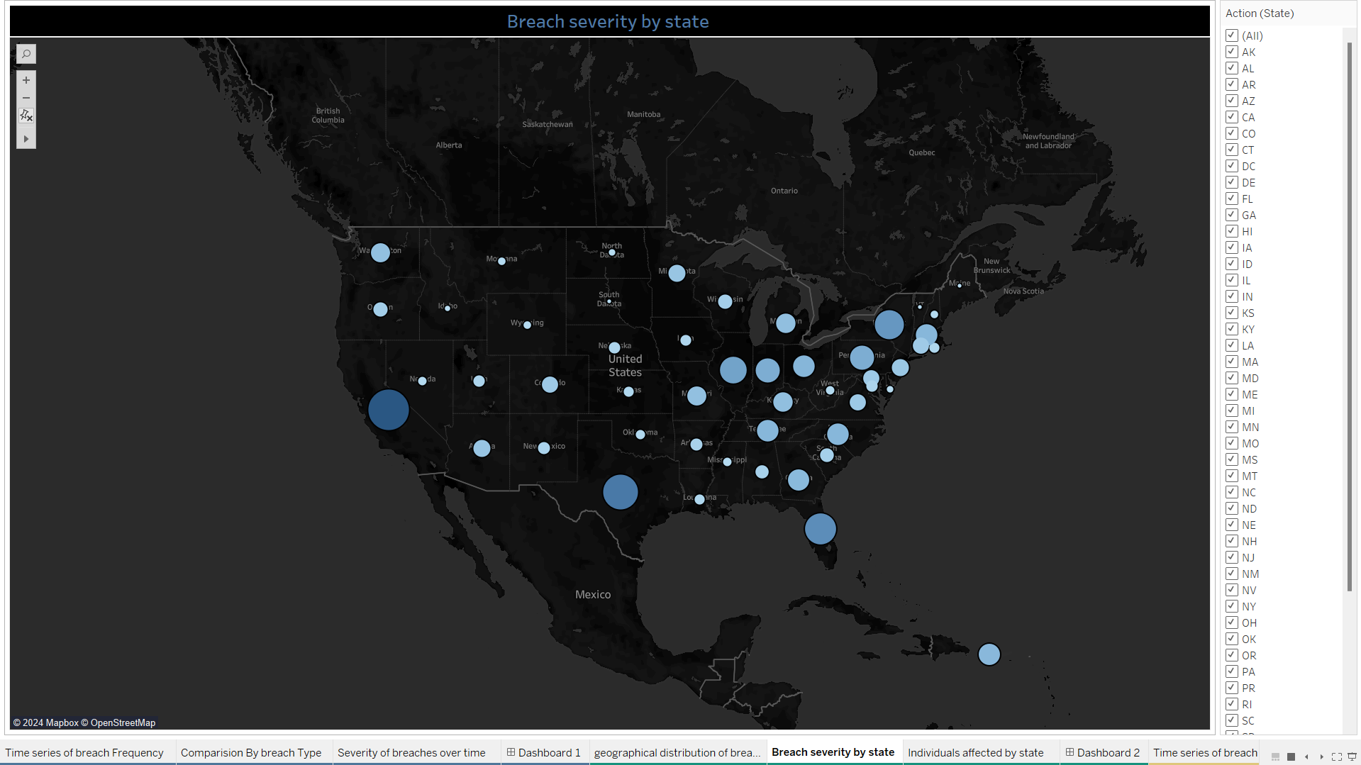
Bubble Map:
Result:
Geographical Insights: Areas with larger bubbles, as in the Northeast and West Coast, indicate higher severity, which could be critical to regional security operations and resource allocation.
Resource Allocation: With this data, organizations and governments can make decisions about intensifying cybersecurity measures.
Strategic Planning: This information can be used by companies for risk assessment, to invest in the right infrastructures, and determine regional priorities for cybersecurity enhancements.

Slide 16
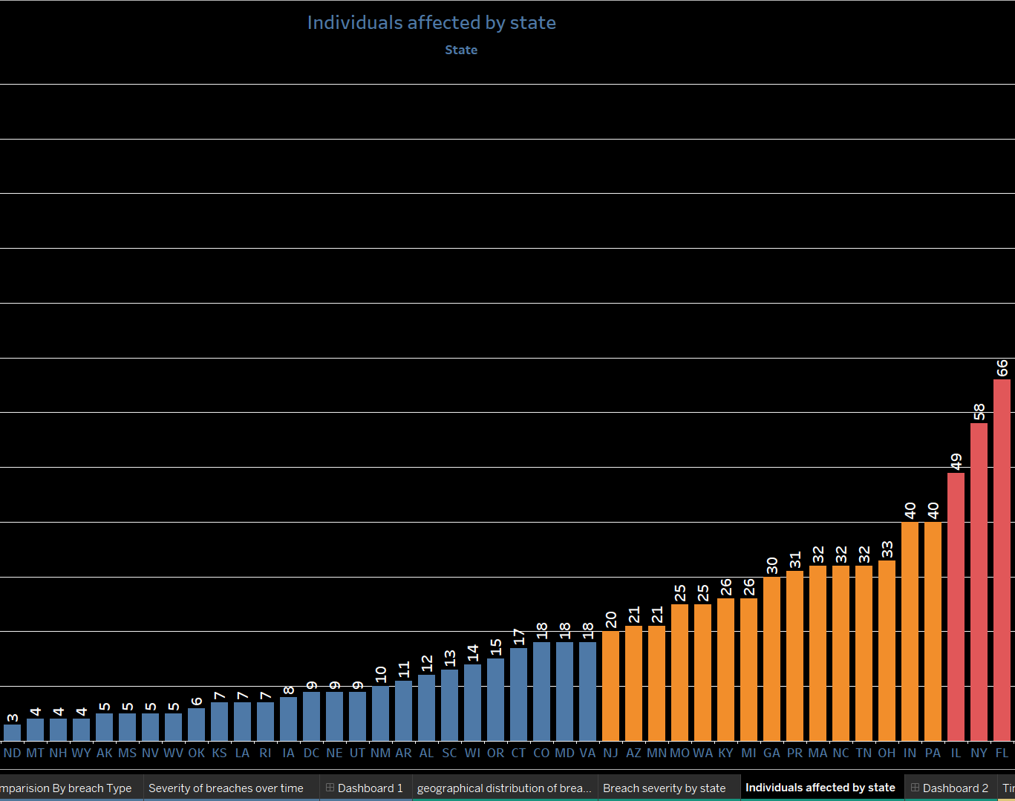
Bar Graph
Result:
The number of affected individuals by cybersecurity breaches in California, Texas, and Florida is highest, crossing over 100. This indicates high involvement of the state due to a high population density, higher business prevalence, or commonness of the breach or seriousness of breach incidents.
NY and PA also show considerable numbers, indicating a comparatively bigger impact of breaches in these states.

Slide 17
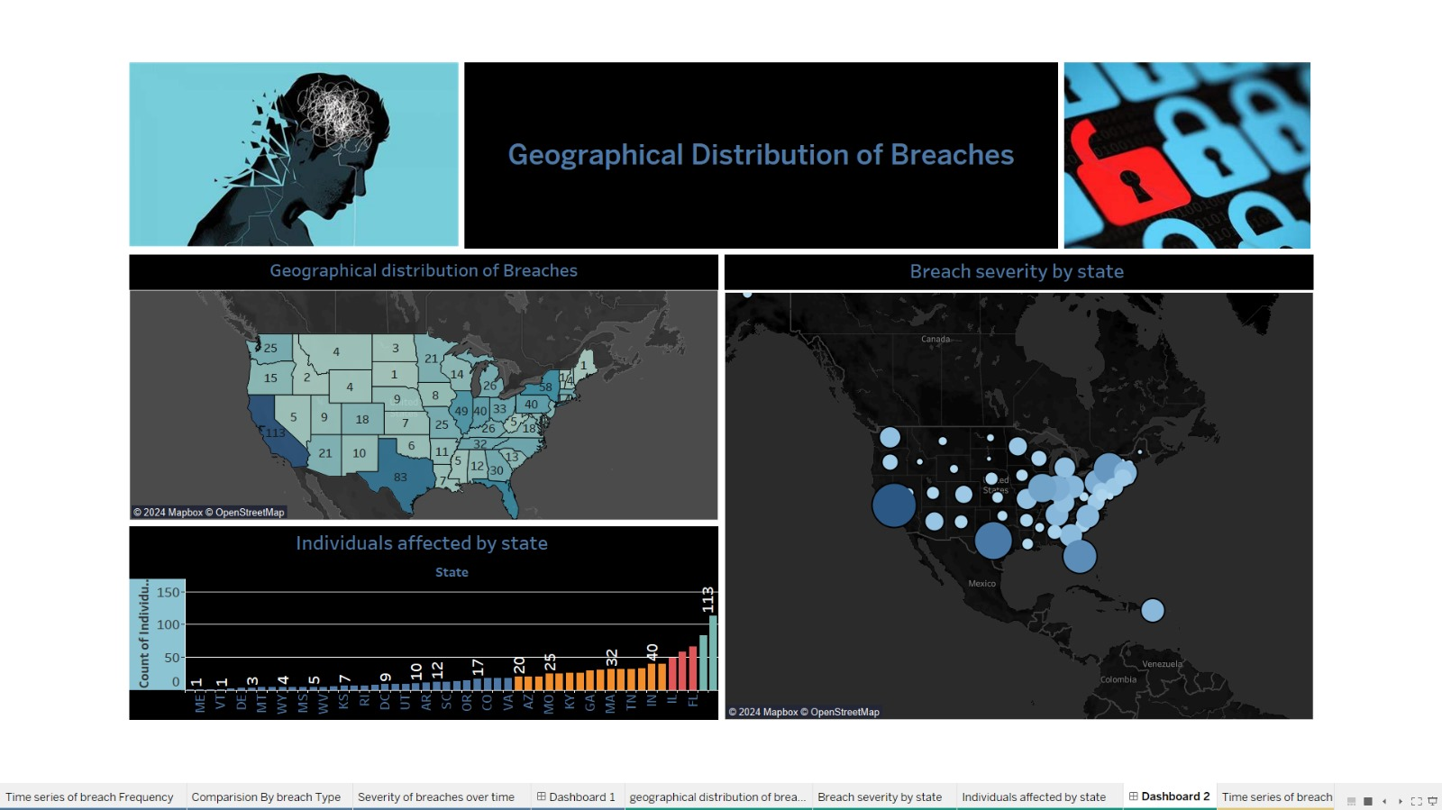
Dashboard 2
Result:
.More populous states and those with higher business activities, such as California and Texas, have a higher rate of breaches, which are also more severe, affecting higher numbers of people. This integrated visualization approach provides valuable insights for policymakers, cybersecurity professionals, and the general public to understand and react to the landscape of cybersecurity threats in the United States.

Slide 18
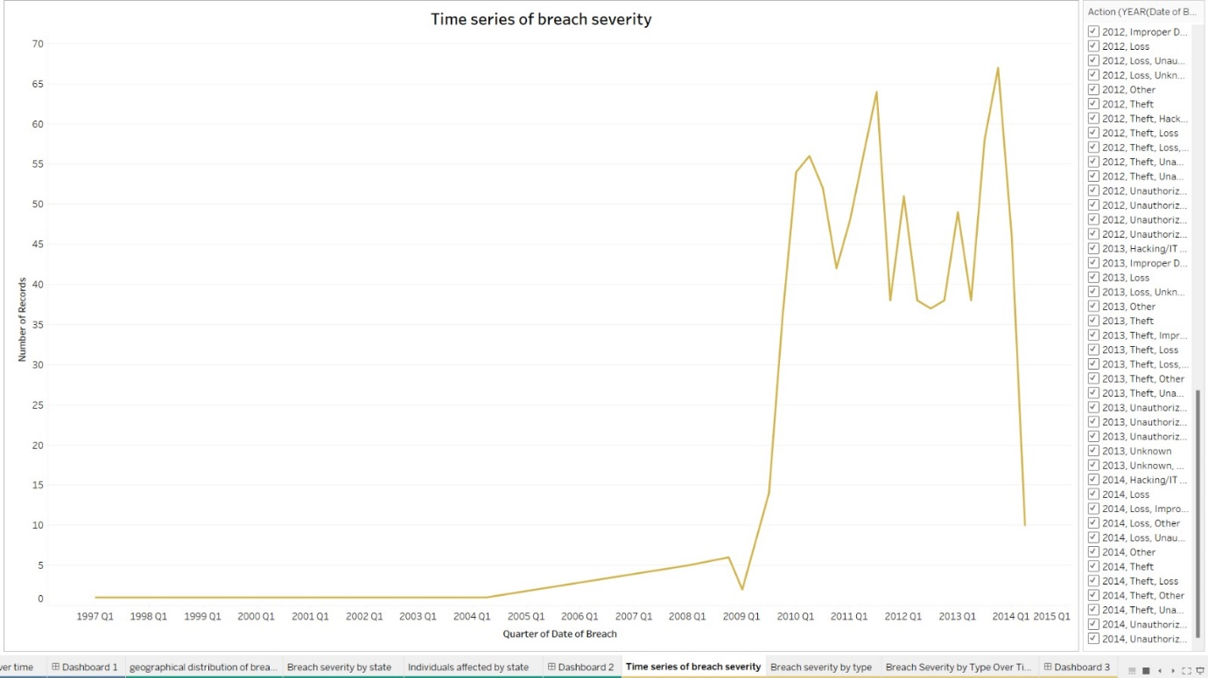
3) Why is the increase in mass-shootings over years considering the gender, ethnicity and mental issues that led to unreasonable end of one’s life? What are the top incident areas for possible chance of mass-shooting?
Result:
The graph of the results indicates that, with a few reversals, the trend of high severity seems to peak in 2010-2011, pointing to a critical period that might need further analysis to understand the underlying causes. It also shows efforts to mitigate breaches possibly being effective, as can be evidenced by the subsequent decline in the number of records following this peak. In general, the upward trend indicates that breaches are increasingly a concern that calls for increased attention and adaptation of cybersecurity strategies

Slide 19
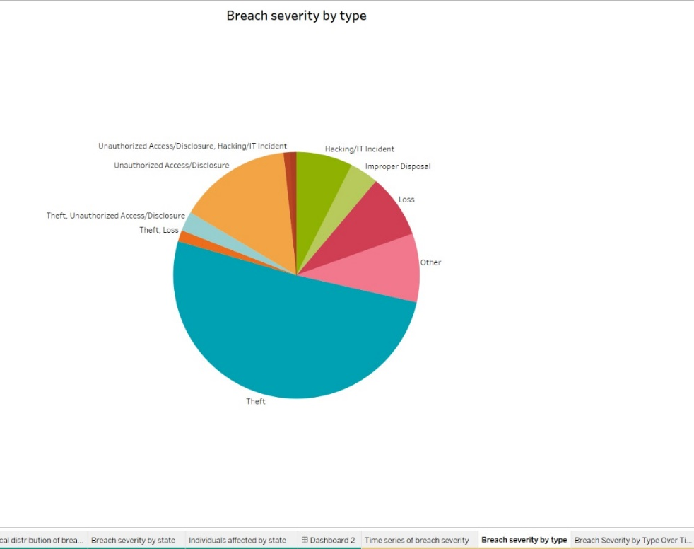
C) Pie Chart
Result:
Theft is the dominant issue, suggesting that physical security and asset management are critical areas needing attention and improvement.
Hacking/IT incidents and unauthorized access/disclosure are also high, showing the need for advanced cybersecurity measures, network security, and data access controls in order to prevent breaches from this type.

Slide 20
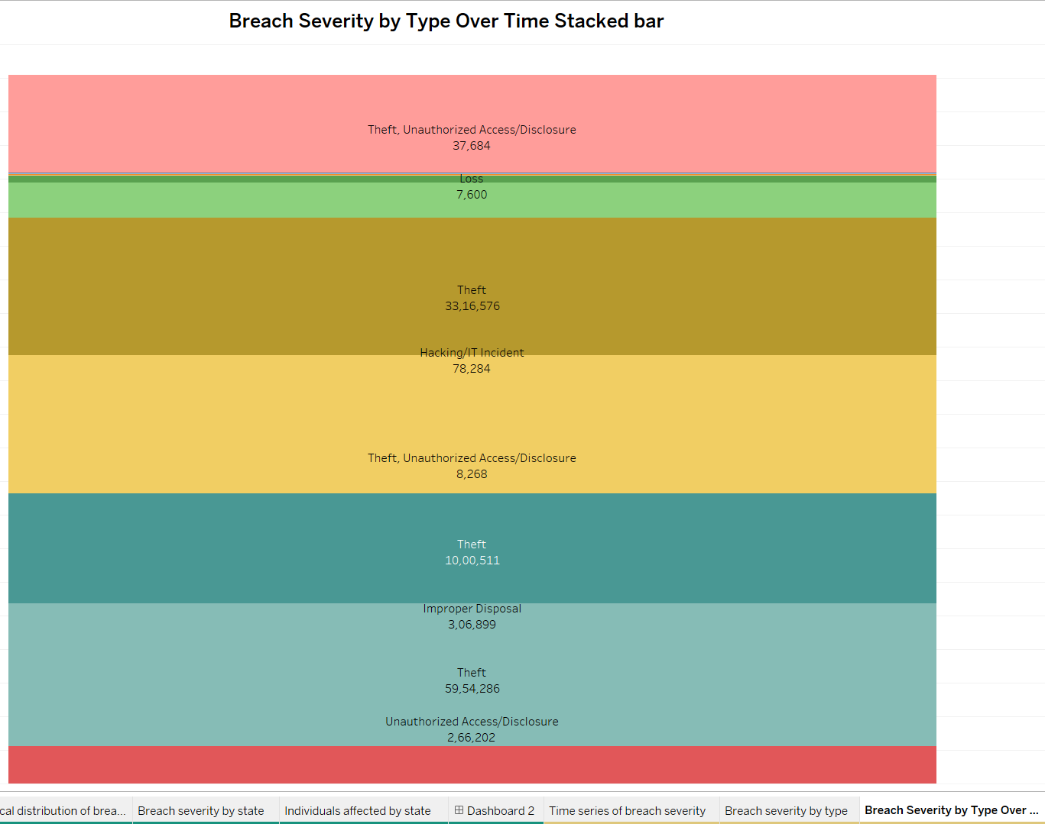
Stacked Bar Graph:
This graph gives the holistic perspective of the breach type distribution and severity, underlining the dire need to direct cybersecurity improvements into the most-affected areas, particularly in fighting theft and strengthening defenses against hacking incidents. The provided data will empower strategic decisions over cybersecurity investment, policy formulation, and operational adjustments in better protection for sensitive information and systems.

Slide 21
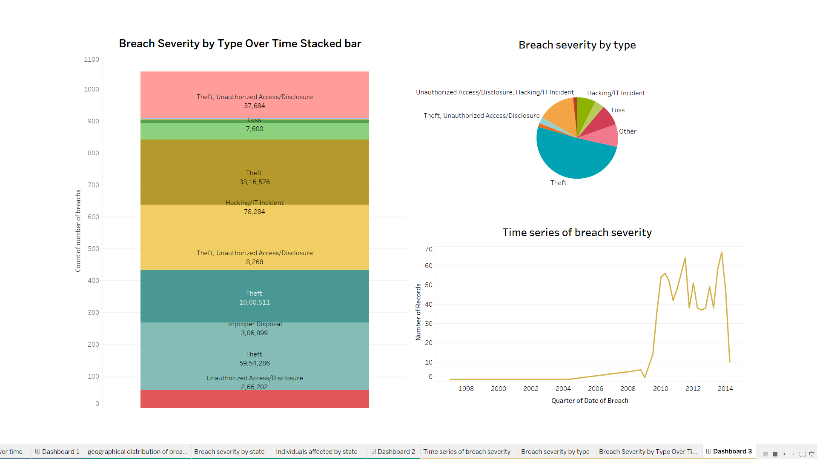
Dashboard 3
By the data shown in the dashboard, it is no doubt that the severity of breaches has gone through many changes over the years. The number of breaches and the nature of these breaches have changed to an increase in both the complexity and impact of the incidences. These trends are well exemplified by the dashboard, which confirms the hypothesis that the severity of breaches has indeed changed over time, with an upward trend in the number and severity of incidents.

Slide 22
Conclusion
This comprehensive analysis of cybersecurity breaches over the period of five years sets focus on various key dynamics in the realm of cyber threats and security incidents across the United States. Leveraging data visualization tools, we have been able to carve out and display the details of these breaches in a detailed manner, giving clarity on their nature, frequency, and the effect they cause.

Slide 23
References
Kerem Gülen, AI and Ethics: Balancing progress and protection – Jan 16, 2023 - https://dataconomy.com/2023/01/16/artificial-intelligence-security-issues/
Petar Radanliev, David De Roure, Carsten Maple, Uchenna Ani, Super forecasting the technological singularity risks from artificial intelligence - https://arxiv.org/ftp/arxiv/papers/2301/2301.10028.pdf
Abhilash Chakraborty, Anupam Biswas, Ajoy Kumar Khan, Artificial Intelligence for Cybersecurity: Threats, Attacks and Mitigation - https://arxiv.org/ftp/arxiv/papers/2209/2209.13454.pdf
Andrew J Lohn, Krystal Alex Jackson, Will AI Make Cyber Swords or Shields: A few mathematical models of technological progress - https://arxiv.org/pdf/2207.13825.pdf

Slide 24
Thank you

